Slide 1







WORKSHOP
Respect starts early: Preparing for tackling peer harassment in primary schools
https://projectartemis.eu/

Slide 2

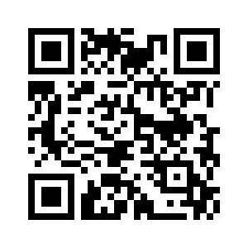
Introduction
Every child deserves a safe classroom, where respect, consent, and empathy are part of daily life.
What does a safe classroom mean to you?

Slide 3

Understanding peer-on-peer sexual harassment
What are the forms of peer-on-peer sexual harassment?
Verbal
Non-verbal
Visual
Physical
(teasing, name-calling, sexualised jokes)
(gestures, staring, sharing content)
(images, offensive web content, exhibitionism, gestures)
(unwanted touching, invading personal space)

Slide 4

Understanding peer-on-peer sexual harassment
Henry, A. (2011). Les pièges de la mixité scolaire. Éditions de la Découverte.
Manly, Stewart & Finaldi. (2021). What is visual sexual abuse? Manly, Stewart & Finaldi.
https://www.manlystewart.com/blog/what-is-visual-sexual-abuse/
Núñez, J. L., Martín-Albo, J., & Navarro, J. G. (2021). Psychological impact of visual harassment on self-esteem and participation in school. Journal of Childhood Education, 34(3), 221-235.
Pathmendra, P., Silva, D., & Gunasekera, R. (2023). Normalising harmful behaviour: The influence of inappropriate content on schoolchildren’s social relationships. International Journal of Social Research, 27(4), 123-138.
UNICEF (2021). Protection of children from the harmful impacts of pornography. United Nations Children’s Fund.
https://www.unicef.org/
Zambeta, E. (2019). Challenges for migrant educational integration in different European welfare systems. Hungarian Educational Research Journal, 9(3), 379-387.

Slide 5
Understanding peer-on-peer sexual harassment
What are the causes of peer-on-peer sexual harassment?
Normative masculinity
Lack of education about age-appropriate relationships, boundaries & consent
Peer pressure
Lack of awareness & Education for teachers
Influence of media

Slide 6
Understanding peer-on-peer sexual harassment
Budde, J., Witz, C., & Böhm, M. (2022). Sexual boundary violations via digital media among students. Frontiers in Psychology, 12, Article 755752. https://doi.org/10.3389/fpsyg.2021.755752
Chiang, L. F., Kress, H., Sumner, S. A., Gleckel, J., Kawemama, P., & Gordon, R. N. (2016). Violence Against Children Surveys (VACS): towards a global surveillance system. Injury prevention, 22(Suppl 1), i17-i22.
Collet, I. (2016). L'égalité fille-garçon : une exigence dans la formation des enseignants. ESF Sciences Humaines.
David, A. (2020). The role of discourse in social theory: The work of Michel Foucault. Sociology Review, 24–27.
https://ueaeprints.uea.ac.uk/id/eprint/77443
Debarbieux, E., Alessandrin, A., Dagorn, J., & Gaillard, O. (2018). Les violences sexistes à l’école: Une oppression viriliste. Observatoire Européen de la Violence à l’École. UNGEI.
Fize, M. (2003). Sexisme à l’école: Les élèves face aux préjugés. Paris: Editions de l'Aube.
Flecha, A., García, R., & Rudd, R. (2011). Using health literacy in school to overcome inequalities. European Journal of Education, 46(2), 209-218.
Irvine, N. (2021). How to identify and deal with toxic masculinity. Edgar. https://www.edgar.ae/articles/how-toidentify-and-deal-with-toxic-masculinity.

Slide 7
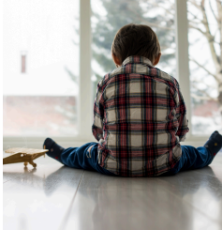
Understanding peer-on-peer sexual harassment
What are some effects of peer-on-peer sexual harassment?
01
02
03
Emotional and psychological harm
Academic
difficulties
Social isolation

Slide 8
Understanding peer-on-peer sexual harassment
Bannister Dean. (2019). Sexual harassment and the unheard voices of students. Educational Journal, 12(4), 34-39.
Ginestra, J. (2020). The emotional toll of sexual harassment in schools. Journal of Mental Health in Education, 56(2), 78-85.
Institute for Educational Reform and Advocacy (IDRA). (2018). Sexual harassment – Safe learning environments for all students. https://www.idra.org/safe-schools/sexual-harassment
Konlan, D., & Dangah, M. (2023). Sexual harassment and its impact on students’ academic performance: Insights
from the educational system. Journal of Educational Studies and Research, 45(3), 150-162.
Moorhead, K. (2019). The normalisation of verbal violence: How schools fail girls. Gender & Education Review, 31(7), 102-108.
Vega-Gea, E., Ortega-Ruiz, R., & Sánchez, V. (2016). Peer sexual harassment in adolescence: Dimensions of the sexual harassment survey in boys and girls. International Journal of Clinical and Health Psychology, 16(1), 47-57. https://doi.org/10.1016/j.ijchp.2015.08.002
Wikström, M. C. (2019). Gendered bodies and power dynamics: The relation between toxic masculinity and sexual harassment. Granite Journal, 3(2), 28-33.

Slide 9

The teacher’s role
Encourage students to set boundaries
“I don’t like this”
“Please stop”
“I can see you’re trying to play, but Alex doesn’t feel comfortable — let’s find another way.”
“This is not fine by me, stop it please”

Slide 10

Education through activities
HOW TO DEVELOP
AN ACTIVITY THAT
HELPS PREVENT SEXUAL HARASSMENT AMONG PEERS

Slide 11

HOW TO DEVELOP AN ACTIVITY THAT HELPS PREVENT SEXUAL HARASSMENT AMONG PEERS
Define the objective of the activity
Define the materials needed
such as worksheets, slides, or digital templates, role cards or case studies
Define the duration of the activity
Decide the format/methodology, such as simulations, role-plays, case studies, card games, group work, problem-solving challenges
Design the structure and develop clear instructions
Include some time for reflection

Slide 12

Education through activities
EDUCATIONAL ACTIVITY FOR TEACHERS
Duration: 30-35'

Slide 13


Educational activity for teachers
Materials
3 short classroom “micro-scenarios” printed or on slides
Coloured cards (green = fair, red = unfair) or small sticky notes
“Sometimes discrimination in classrooms doesn’t look like bullying, as it can appear as a comment, a pattern, or an unnoticed preference.
Let’s look at how these moments can shape the peer climate and contribute to unwanted behaviours.”

Slide 14

Educational activity for teachers
Scenario
Description
Prompt for teachers
The teacher praises the confident, outspoken pupils while quieter children receive little attention. Over time, some pupils start calling one shy child “invisible.”
“Is there any unintentional bias here? How might the teacher’s behaviour influence peer interactions?”
1: “The Loud and the Quiet”
2: “Boys Will Be Boys”
When a boy teases a girl, the teacher laughs it off as ‘normal playful behaviour’. Other children start imitating it.
“How can normalising small acts of disrespect lead to peer-on-peer harassment?”
The teacher always asks the same “responsible girl” to help tidy up or assist new students. Others start calling her ‘teacher’s pet’.
“How can over-rewarding certain behaviours create exclusion or resentment?”
3: “The Helper”
After each scenario:
Teachers raise green (fair) or red (unfair) cards.
Discuss briefly: What message does this send to pupils?
What alternative response could create inclusion?

Slide 15
Educational activity for teachers
Discrimination Risk
Teacher’s Trigger
Inclusive Response
Gender stereotypes
“Boys will be boys.”
Set the same respect rule for all.
Overlooking quiet pupils
Preference for active participation.
Use different formats for engagement (drawing, small groups).
Rewarding the same child
Comfort zone with reliable pupils.
Rotate roles and acknowledge diverse strengths.

Slide 16


Educational activity for teachers
“When students feel seen and valued equally, they are less likely to become targets, and less likely to target others.”

Slide 17


ARTEMIS Activities
Target group: Primary school students
Activity 01
Activity 02
Activity 03
OK or Not OK?
My personal space by colours
Words that build, words that hurt
Understanding consent
Recognising comfort levels
Language awareness

Slide 18
ARTEMIS Activities
OK or Not OK?
Duration: 15-20'

Slide 19
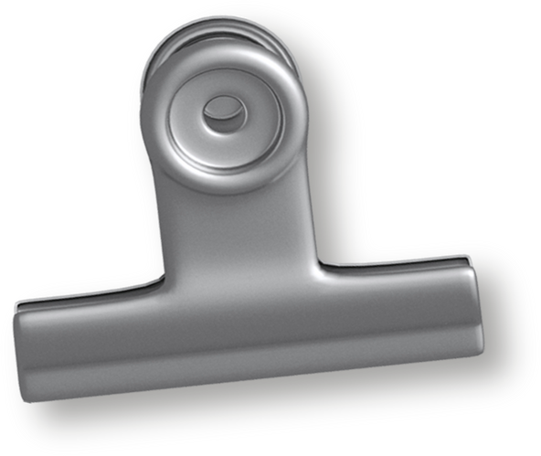


OK or Not OK?
Prepare a set of short, age-appropriate scenarios that involve personal space or consent (e.g., “Someone hugs you without asking,” “You ask before borrowing your friend’s pen,” “A friend holds your hand after you say no”).
Read each scenario out loud or distribute the cards among the students.
Students decide if the behavior is OK (respectful of consent/personal space) or Not OK (crosses boundaries or lacks consent) by holding up the correct card or saying their answer.
After each scenario, briefly discuss why it is OK or Not OK, and how the situation could be handled respectfully if needed.
Instructions

Slide 20





OK or Not OK?
Let’s play and think
Someone hugs you without asking
You tell your friend his/herT-shirt is out of fashion
You ask before borrowing your friend’s pen
You say “no” to someone asking to touch your hair
You hold your friend’s hand while he/she is trying to pull it away
Someone asks you if you want to join their company or stay alone

Slide 21
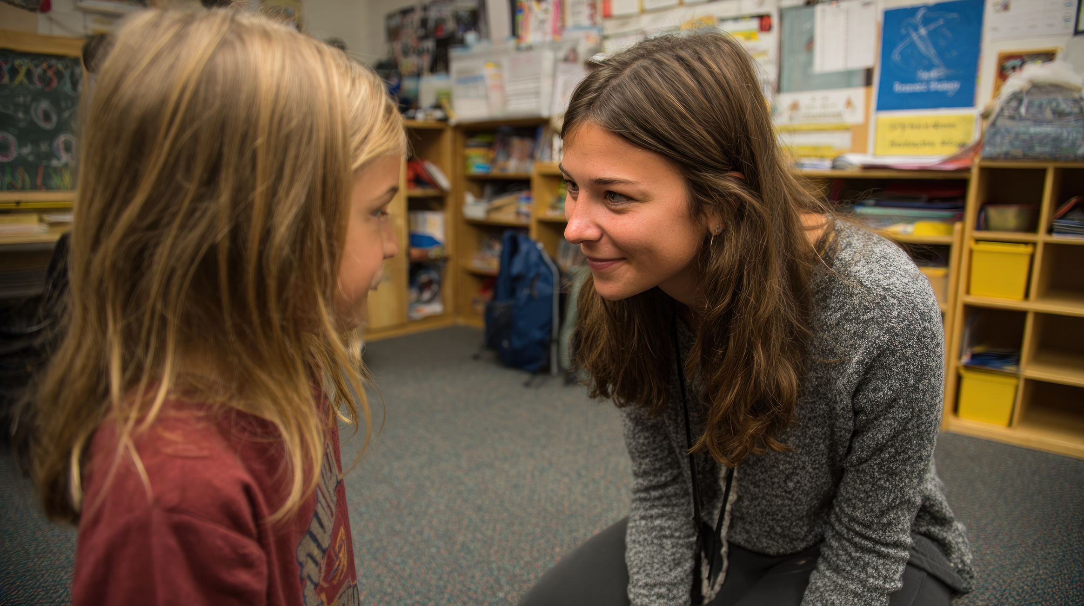
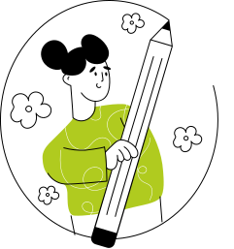
OK or Not OK?
Everyone’s comfort level is different—and that’s OK
We always ask, we listen, and we respect the answer
“Yes, it’s OK”
“No, it’s not OK”

Slide 22
ARTEMIS Activities
My personal space by colours
Duration: 20-25'

Slide 23



My personal space by colours
Draw three circles and colour them green, yellow, red.
In each, write names or roles
Add examples of contact
Remind that there are no right or wrong answers
Parents – Hug
Friends – High-five
Strangers - No touch

Slide 24
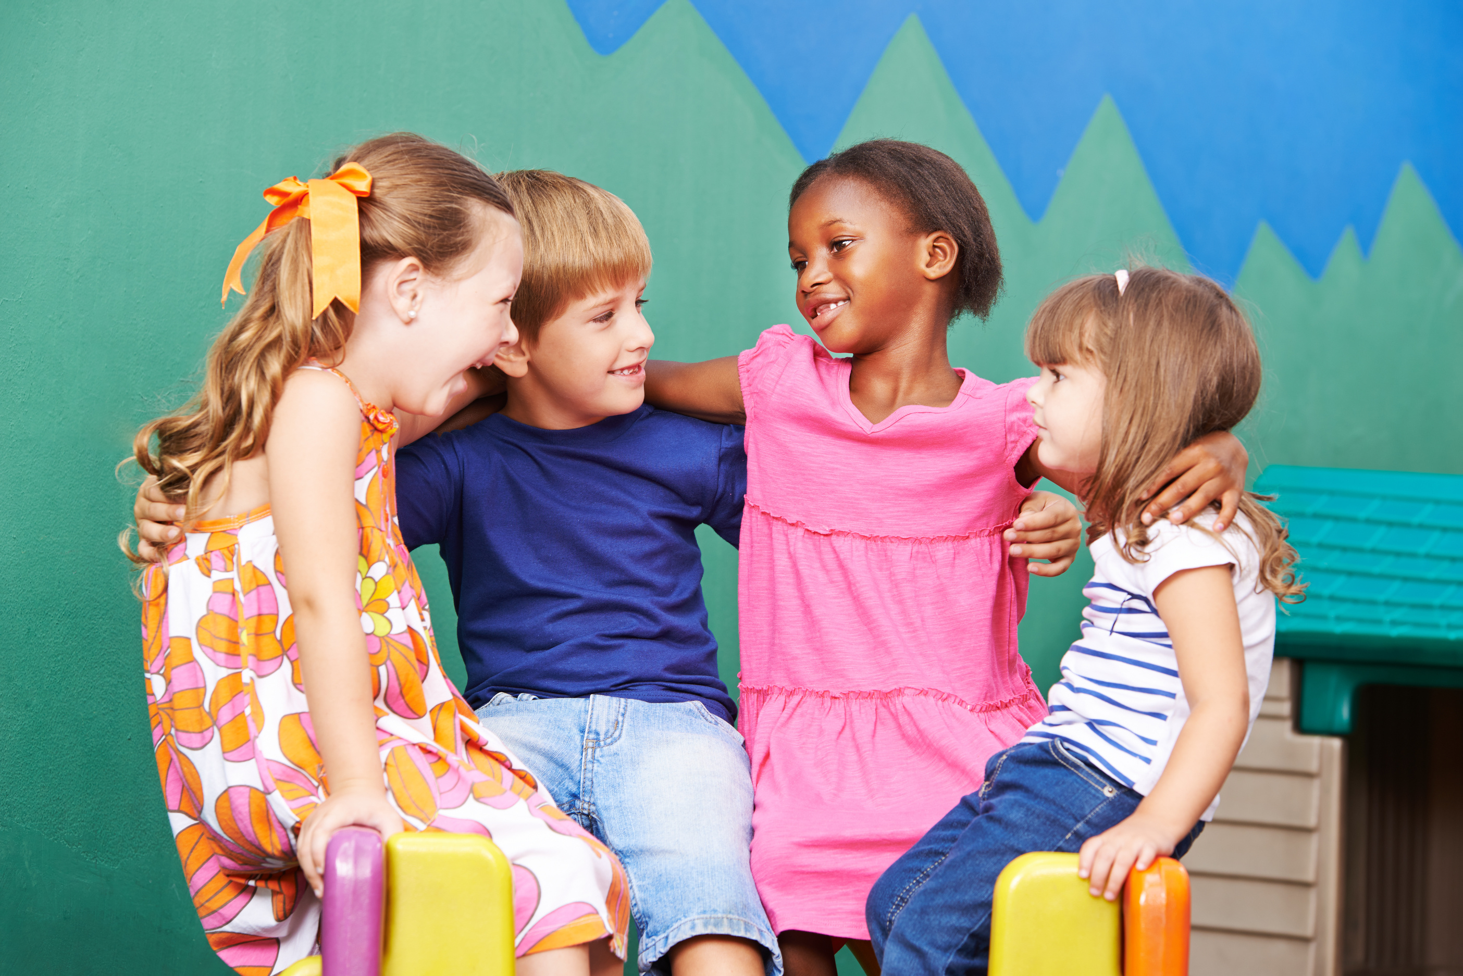
My personal space by colours
The people and the actions that we feel comfortable with differ from one another.

Slide 25
ARTEMIS Activities
Words that build, Words that hurt
Duration: 30-35'

Slide 26
Words that build, Words that hurt
Begin with a short discussion: “How do words make us feel? Can words hurt? Can words help?”.
Distribute strips of paper or sticky notes. Ask each student to write down one example of a word or phrase that could hurt someone (e.g., name-calling, mocking) and one that could build someone up (e.g., compliments, encouragement).
Students place their notes on the correct poster: “Words that Hurt” or “Words that Build”. Read a few examples aloud (without naming who wrote them).
Instructions

Slide 27


Words that build, Words that hurt
We all have the power to choose respectful language
You’re weird
It’s fine. Do you want to join us later?
Words that Build
Words that Hurt
You’re crying like a girl
Why don’t you play football?
Are you a little girl?
You’re gey
You’re beautiful

Slide 28
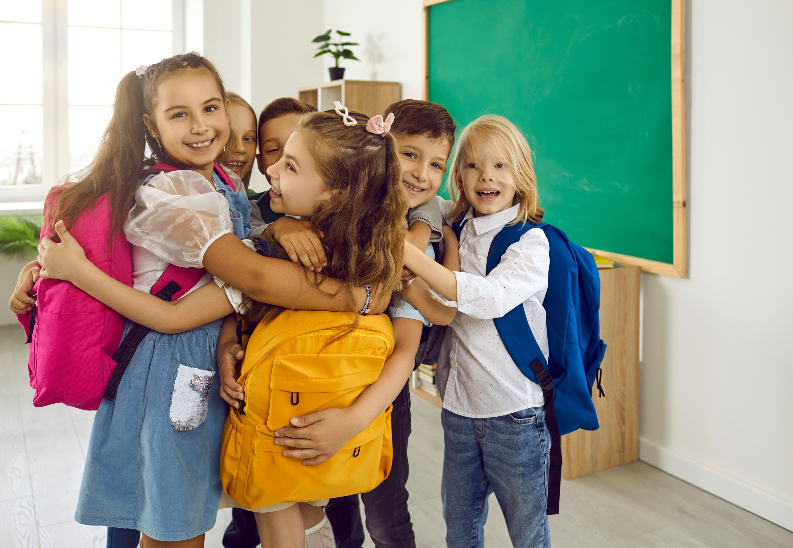
Words that build, Words that hurt
What new words will you start using more often?

Slide 29



QUESTION TIME

Slide 30







PROJECT COORDINATOR
THE PARTNERSHIP
Funded by the European Union. Views and opinions expressed are however those of the author(s) only and do not necessarily reflect those of the European Union or the European Education and Culture Executive Agency (EACEA). Neither the European Union nor EACEA can be held responsible for them.

